Slide 1
Automatic Cool-Mist Humidifier & water refill system
ECE445 – Group 11
Andrew Sherwin (zyxie2@Illinois.edu / (310) 918-9167
Woojin Kim
Jalen Chen

Slide 2
Humidifier
Consists of a filter, fan, water valve, and irrigation system
How does it work?
Three remote sensors sending humidity data to humidifier
Humidifier turns on fan to start humidifying the room
(Humidifier turns fan toward direction that needs most humidity)
The filter needs to be wet. The fan draws out the humidity from the filter.
The DC-motor controlled water valve feeds water to the irrigation pipes to periodically wet the filter. Water sensor determines if more water is needed.
(Rotating head or body to turn humidifier to place that needs most humidity)

Slide 3

Cool-mist humidifier filter
Notes:
https://www.amazon.com/HONEYWELL-Replacement-Wicking-Filter-Count/dp/B07W69P2TK/ref=sr_1_4?crid=681JH0OAIW75&keywords=humidifier%2Bfilter&qid=1707325729&sprefix=humidifier%2Bfilter%2Caps%2C111&sr=8-4&th=1

Slide 4

Water resistant and preferably quiet fan for extracting humidity from wet filter
Notes:
https://www.amazon.com/Coolerguys-120MM-120X120X25-Airflow-Waterproof/dp/B07NMC9X38/ref=pd_ci_mcx_mh_mcx_views_0?pd_rd_w=sxUFJ&content-id=amzn1.sym.225b4624-972d-4629-9040-f1bf9923dd95%3Aamzn1.symc.40e6a10e-cbc4-4fa5-81e3-4435ff64d03b&pf_rd_p=225b4624-972d-4629-9040-f1bf9923dd95&pf_rd_r=8JR7QY3PB6ZN26N4J5AQ&pd_rd_wg=Ish3K&pd_rd_r=895cfc63-f3e0-4c7a-991f-7c7b90c2733c&pd_rd_i=B07NMC9X38

Slide 5
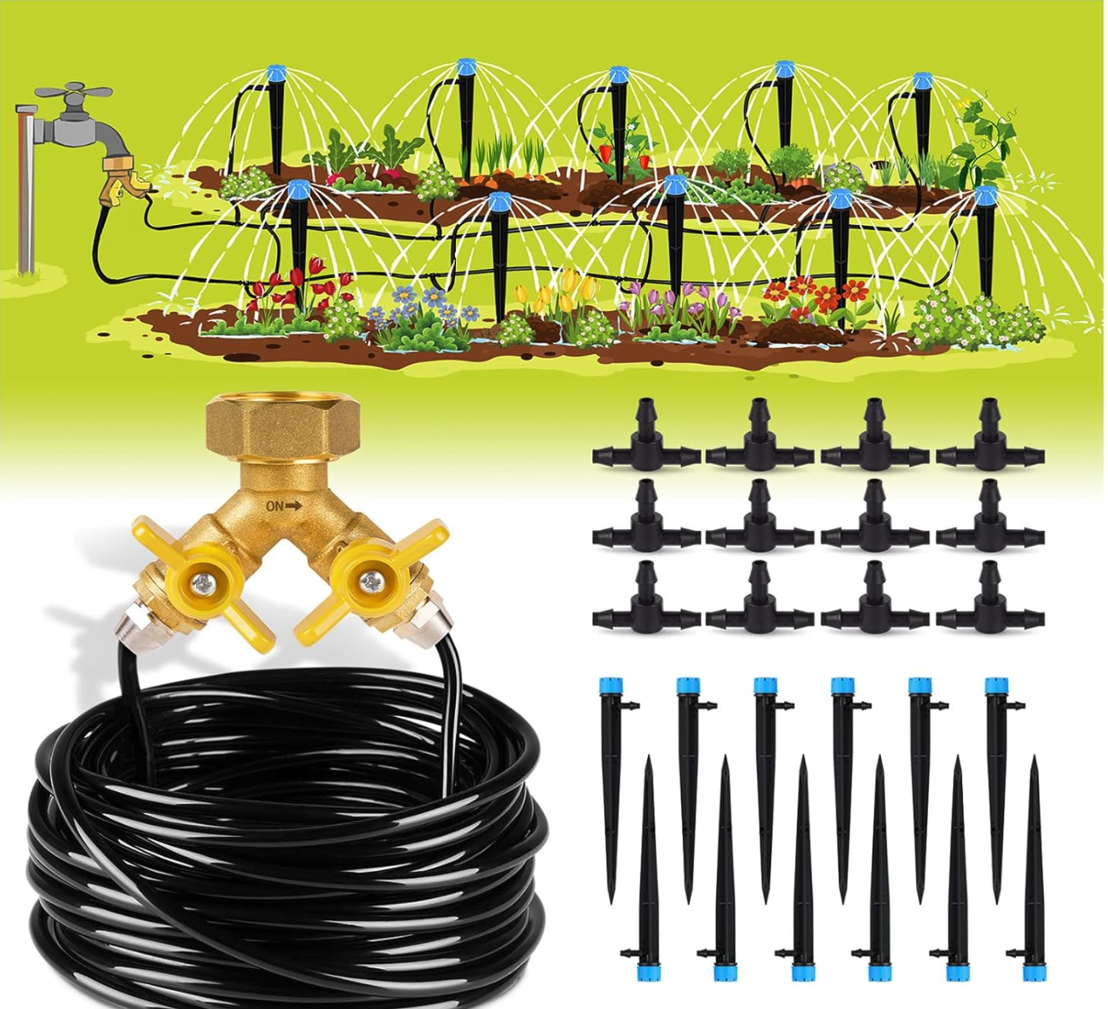
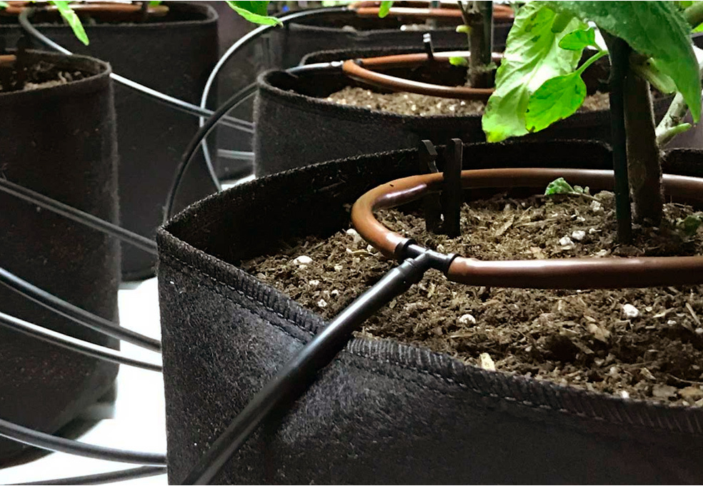
Potential ways to irrigate/wet the filter from slide 1

Slide 6
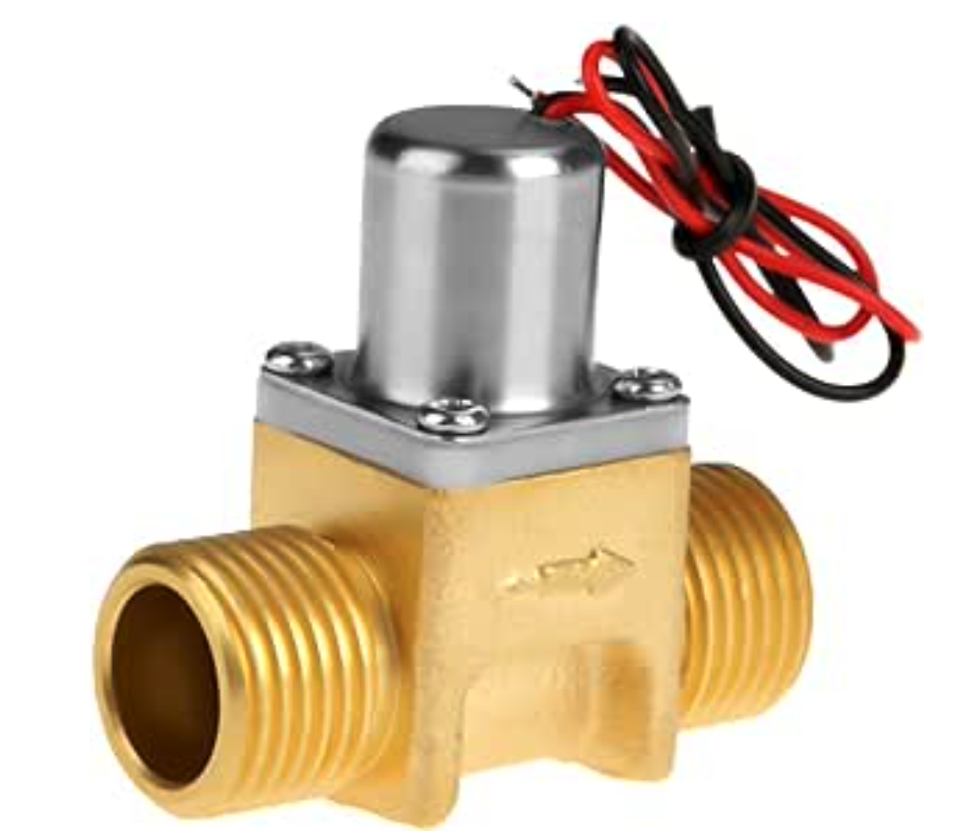
Potential ½” DC water valve control
Notes:
https://www.amazon.com/Water-Electromagnetic-Liquid-Diesel-DC3-6V/dp/B07FX84FYT/ref=asc_df_B07FX84FYT/?tag=hyprod-20&linkCode=df0&hvadid=598245474852&hvpos=&hvnetw=g&hvrand=11700143207841696701&hvpone=&hvptwo=&hvqmt=&hvdev=c&hvdvcmdl=&hvlocint=&hvlocphy=9022196&hvtargid=pla-915369286739&mcid=dddffec669123053a5057ff4f5d94826&gclid=CjwKCAiA8YyuBhBSEiwA5R3-E6oAlcwDb9zo7WgWwODs67O3q9OLB1oAHH9SaVSQ7HHCne3YUN-NIRoCtKcQAvD_BwE&th=1

Slide 7
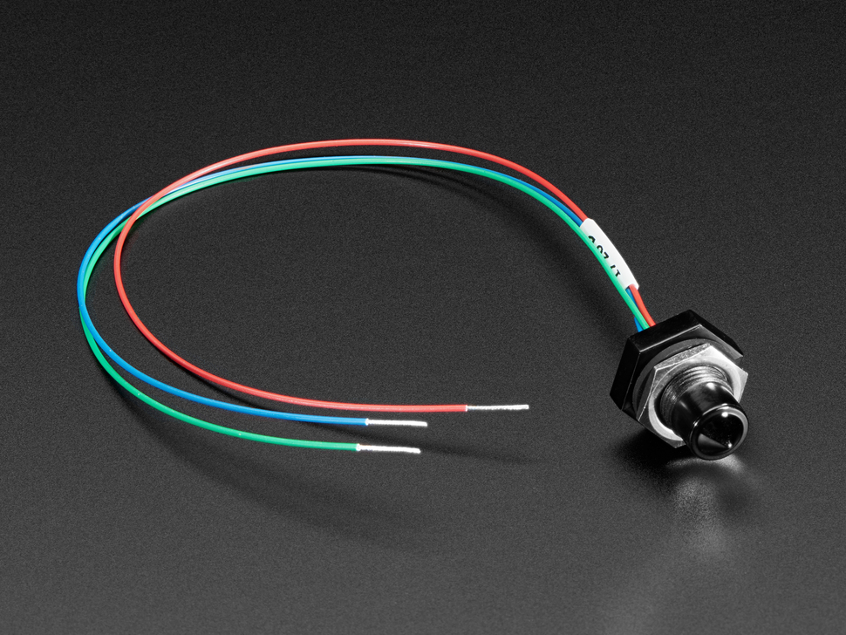
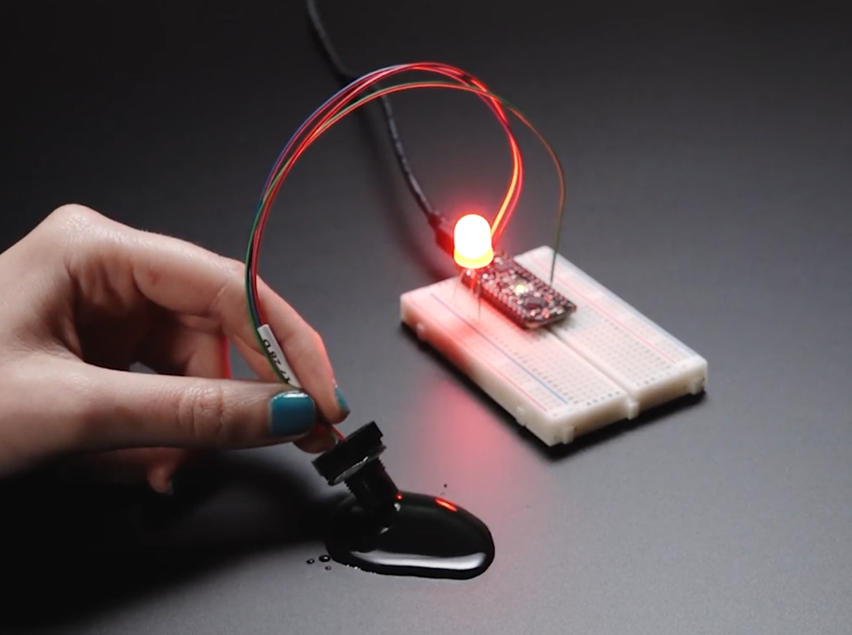
Adafruit Water Level Sensor
Notes:
https://www.adafruit.com/product/3397?gad_source=1&gclid=CjwKCAiA8YyuBhBSEiwA5R3-E6B7SQcdA7hnvmyj9_ijka3YXRK3Aj_dM8Fylm8imfuIDRSNtU48ahoCC9sQAvD_BwE

Slide 8
Similar humidifier for ideas

Slide 9
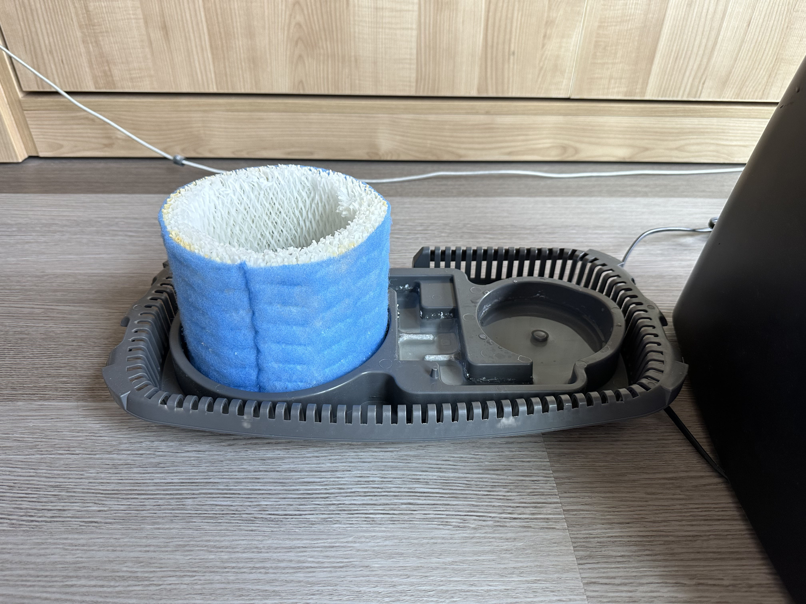

Slide 10
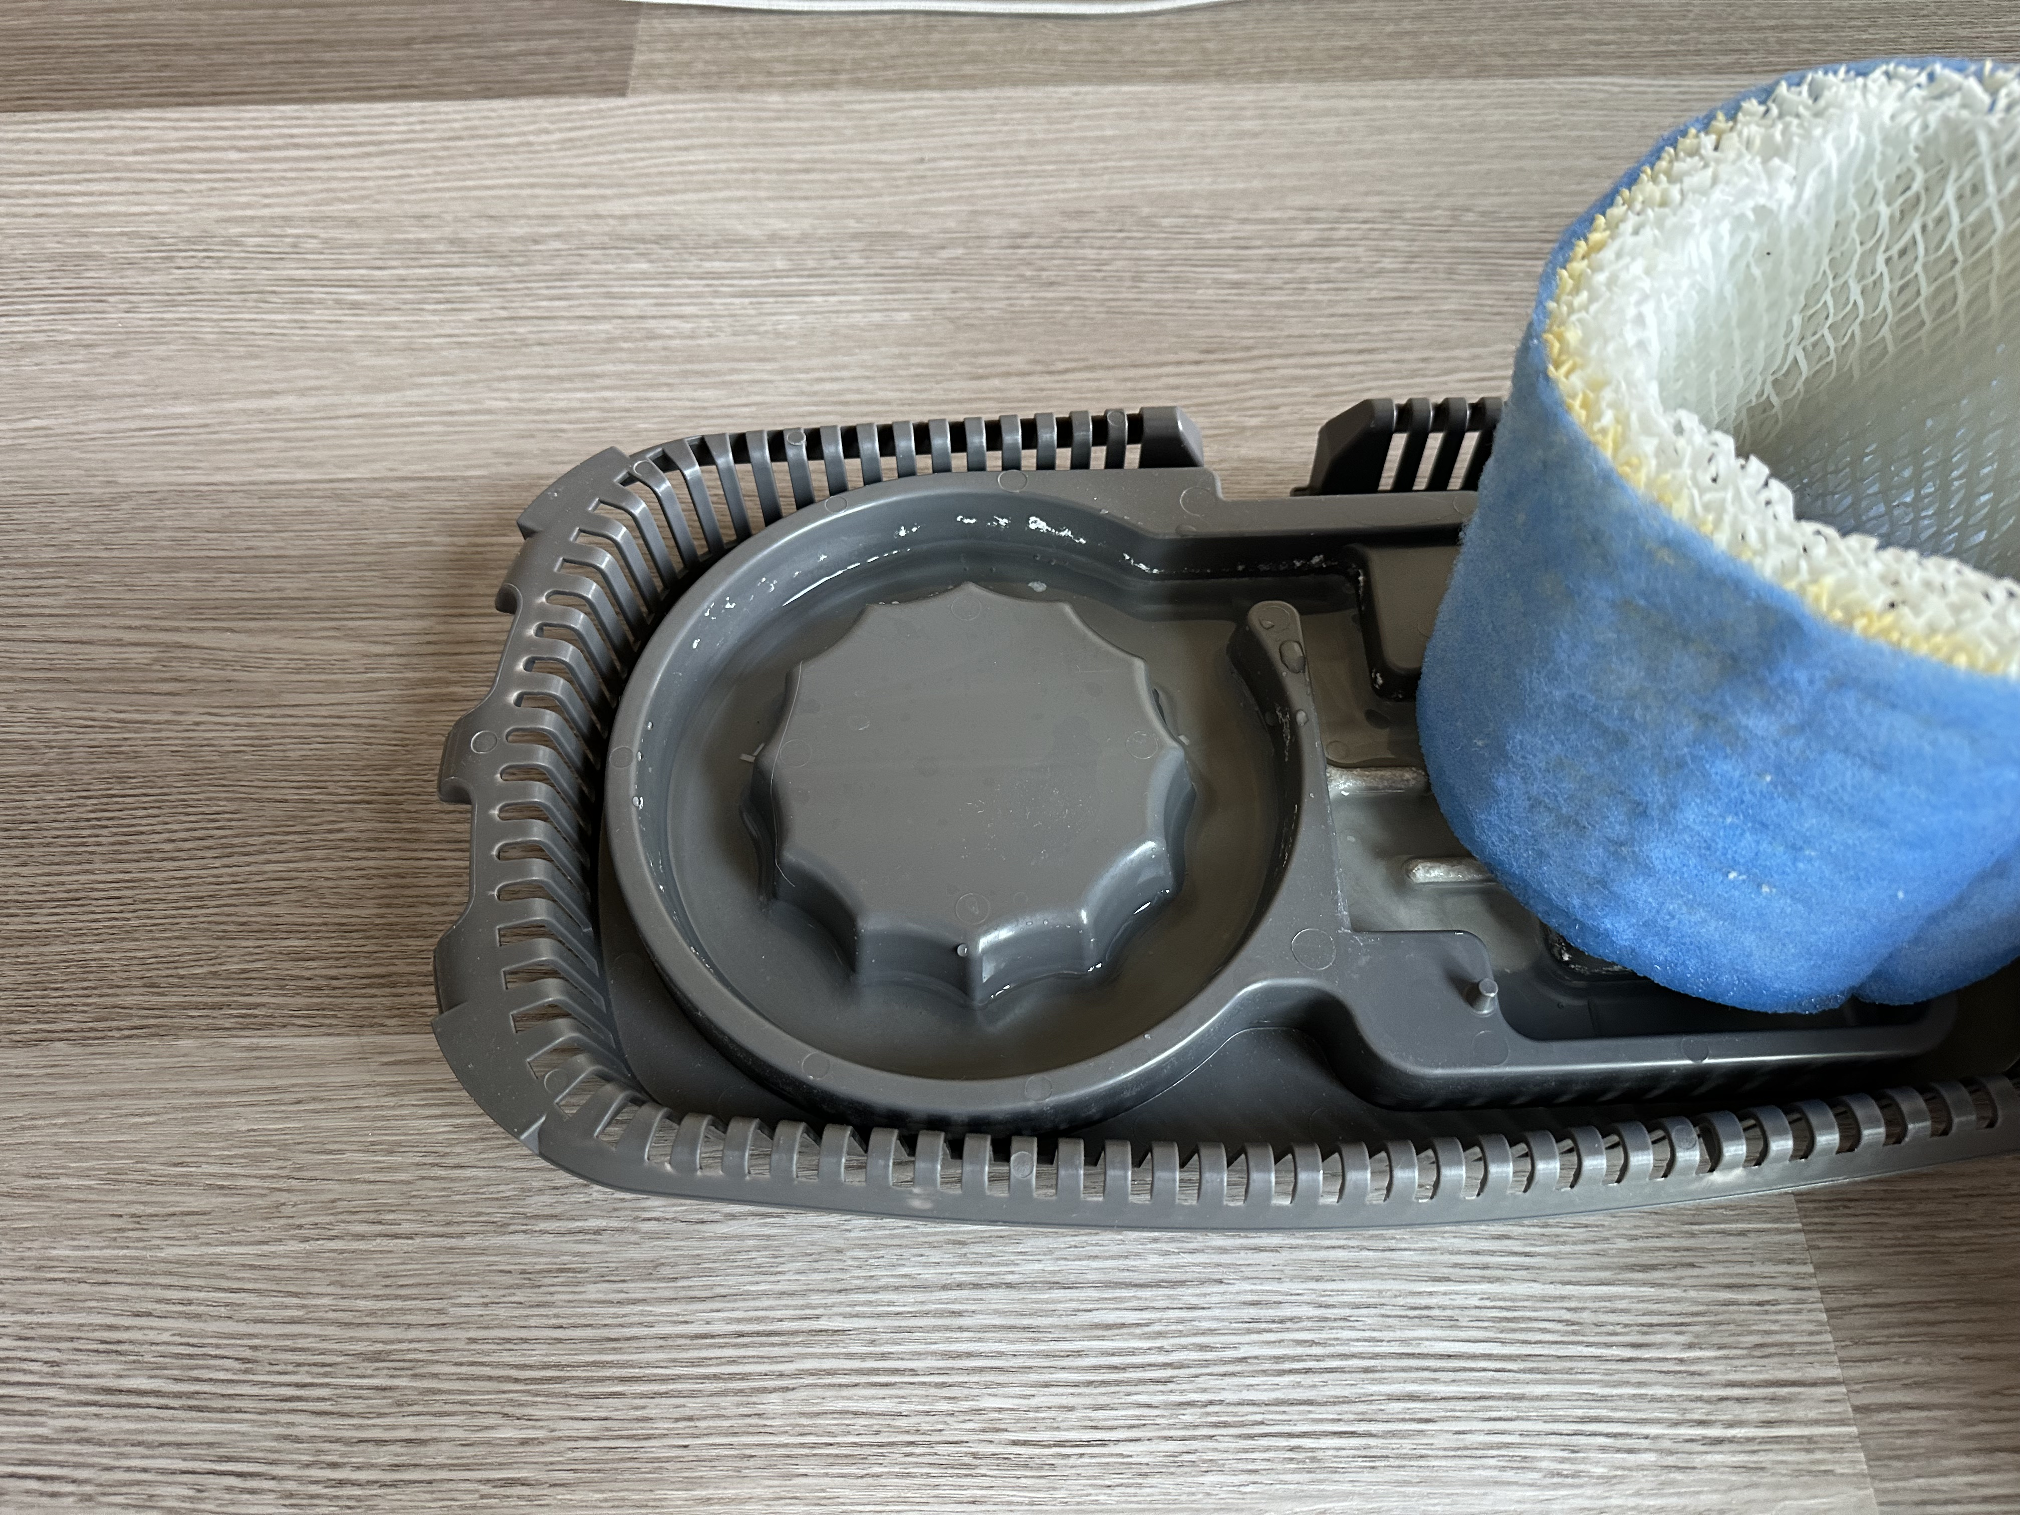

Slide 11
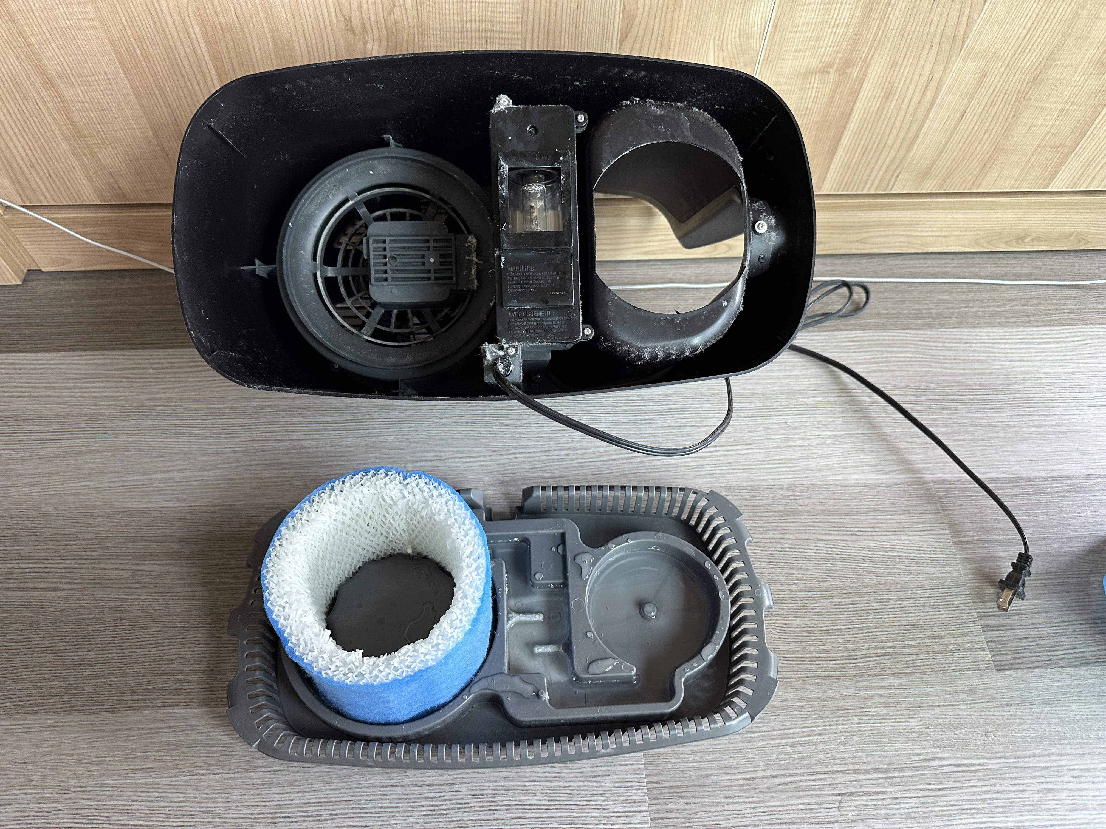

Slide 12
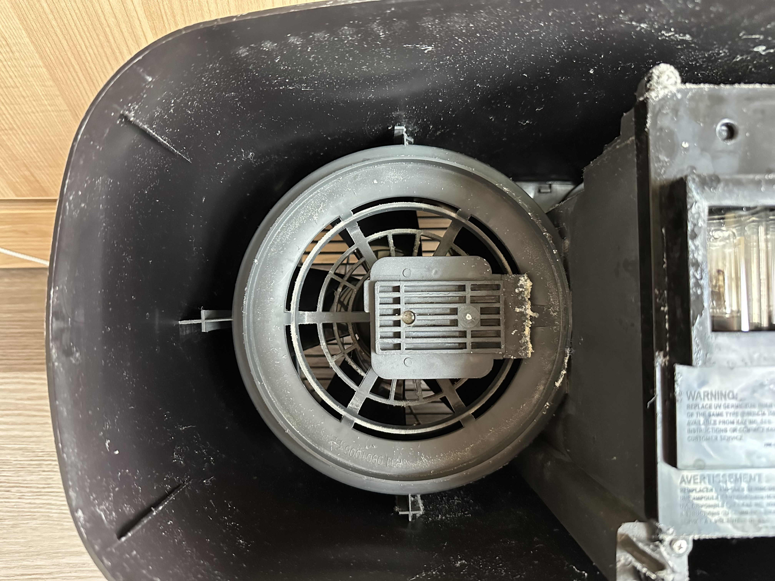

Slide 13
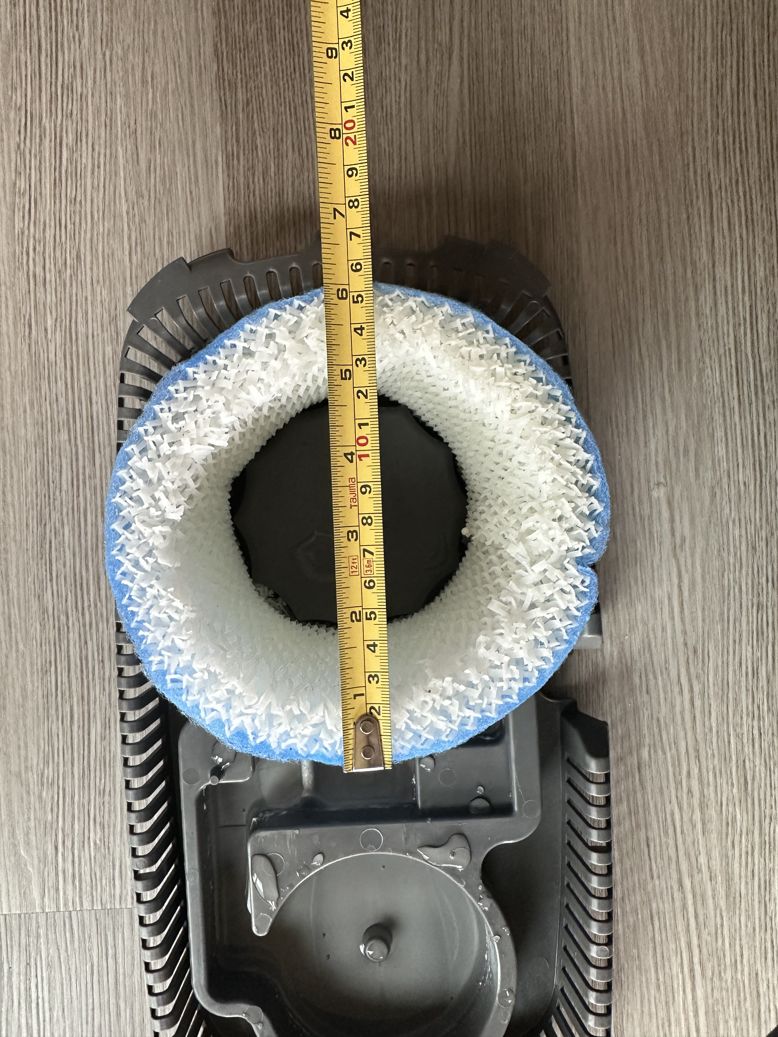

Slide 14
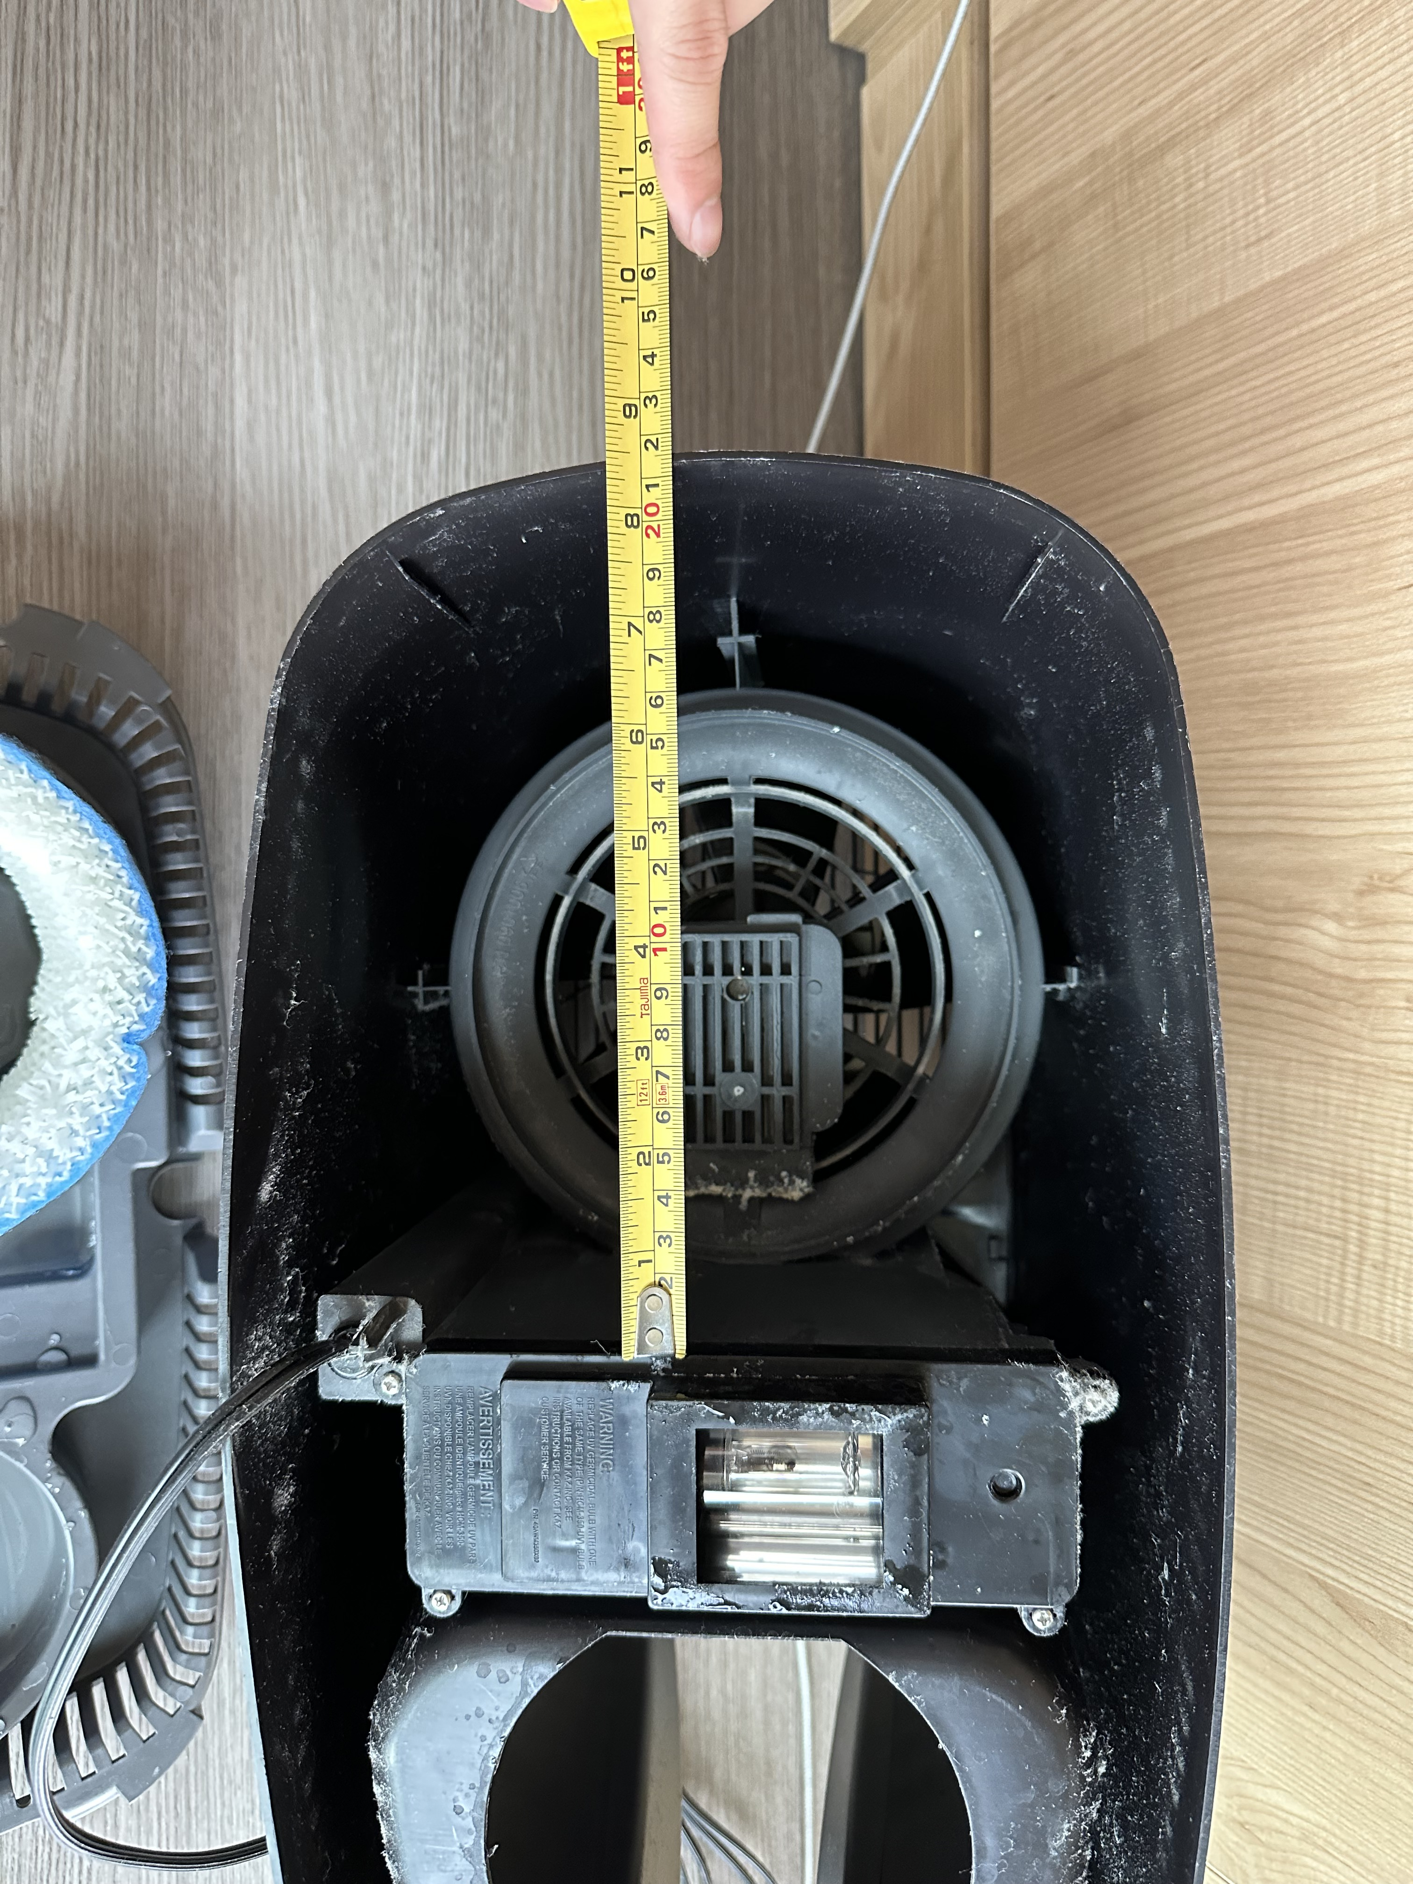

Slide 15
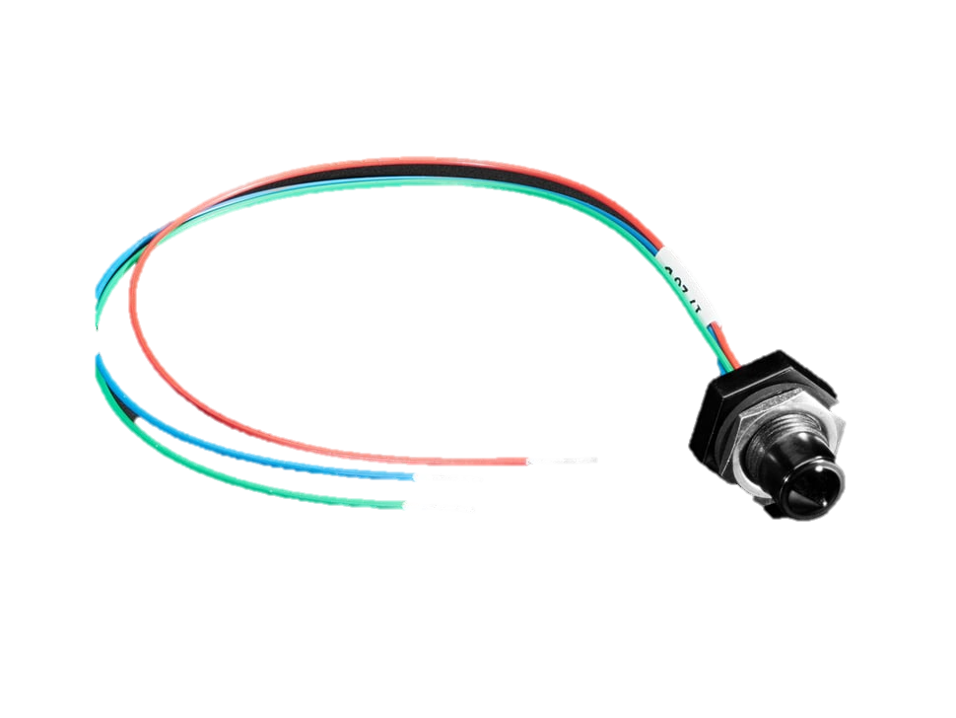

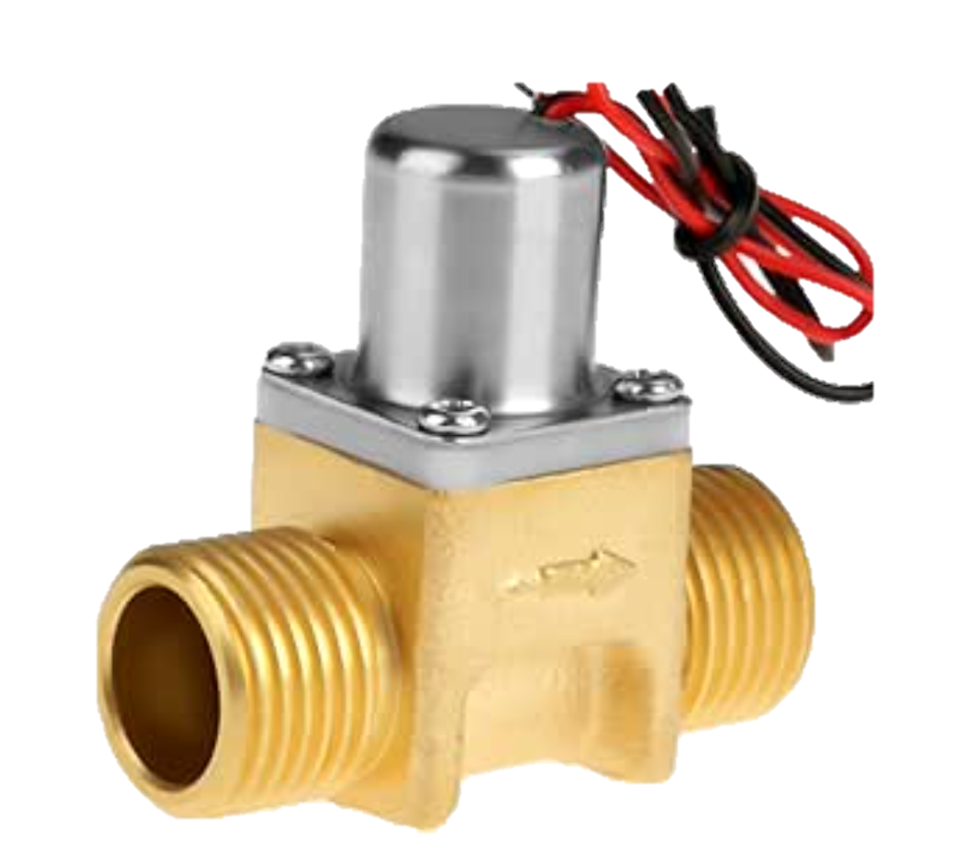

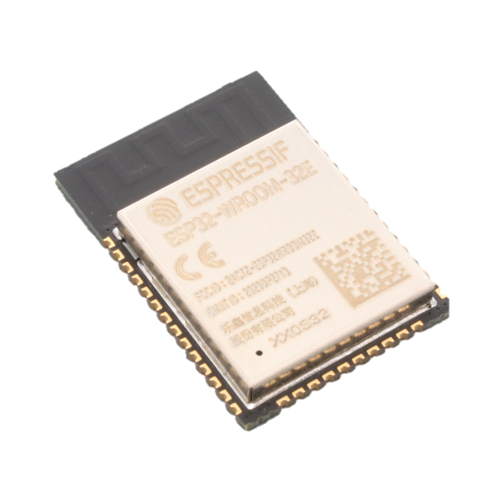
Upper Water Level Sensor
DC Water Valve
Water Tank
Humidifier Fan
Water Filter
Lower Water Level Sensor
ESP32 Microcontroller

Slide 16
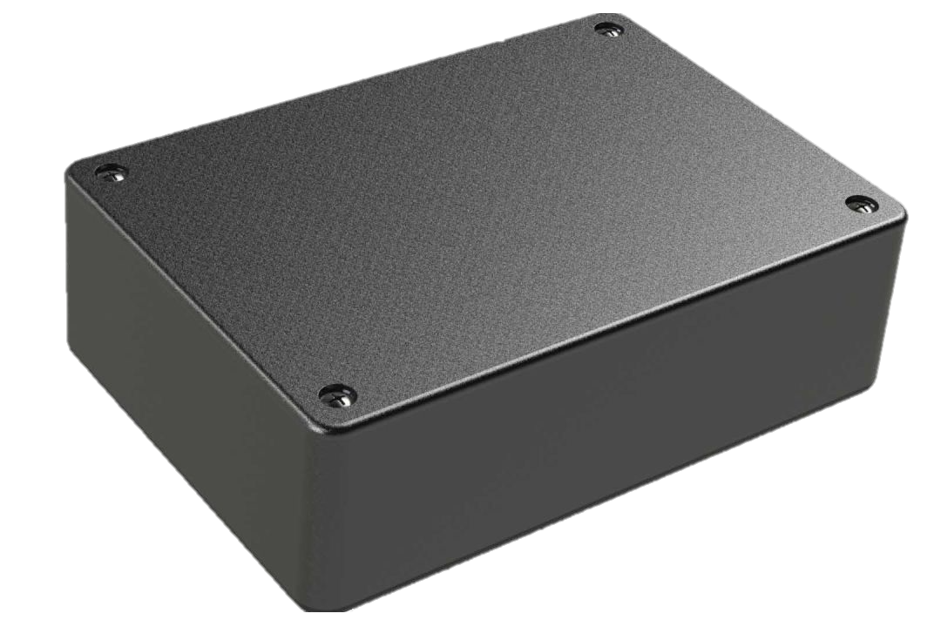
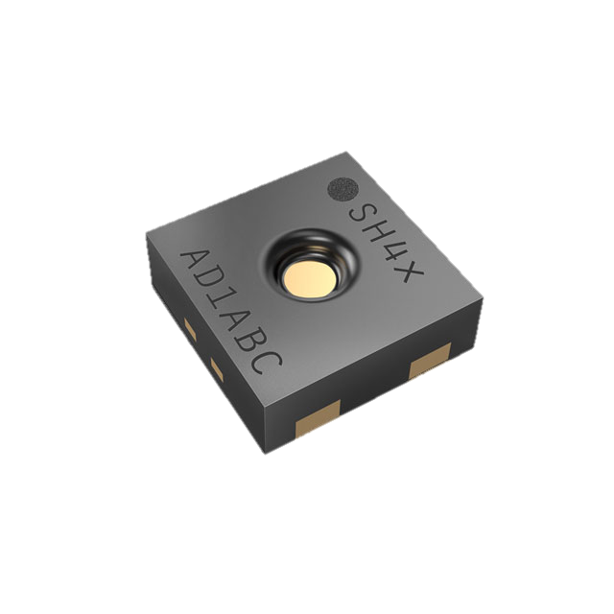
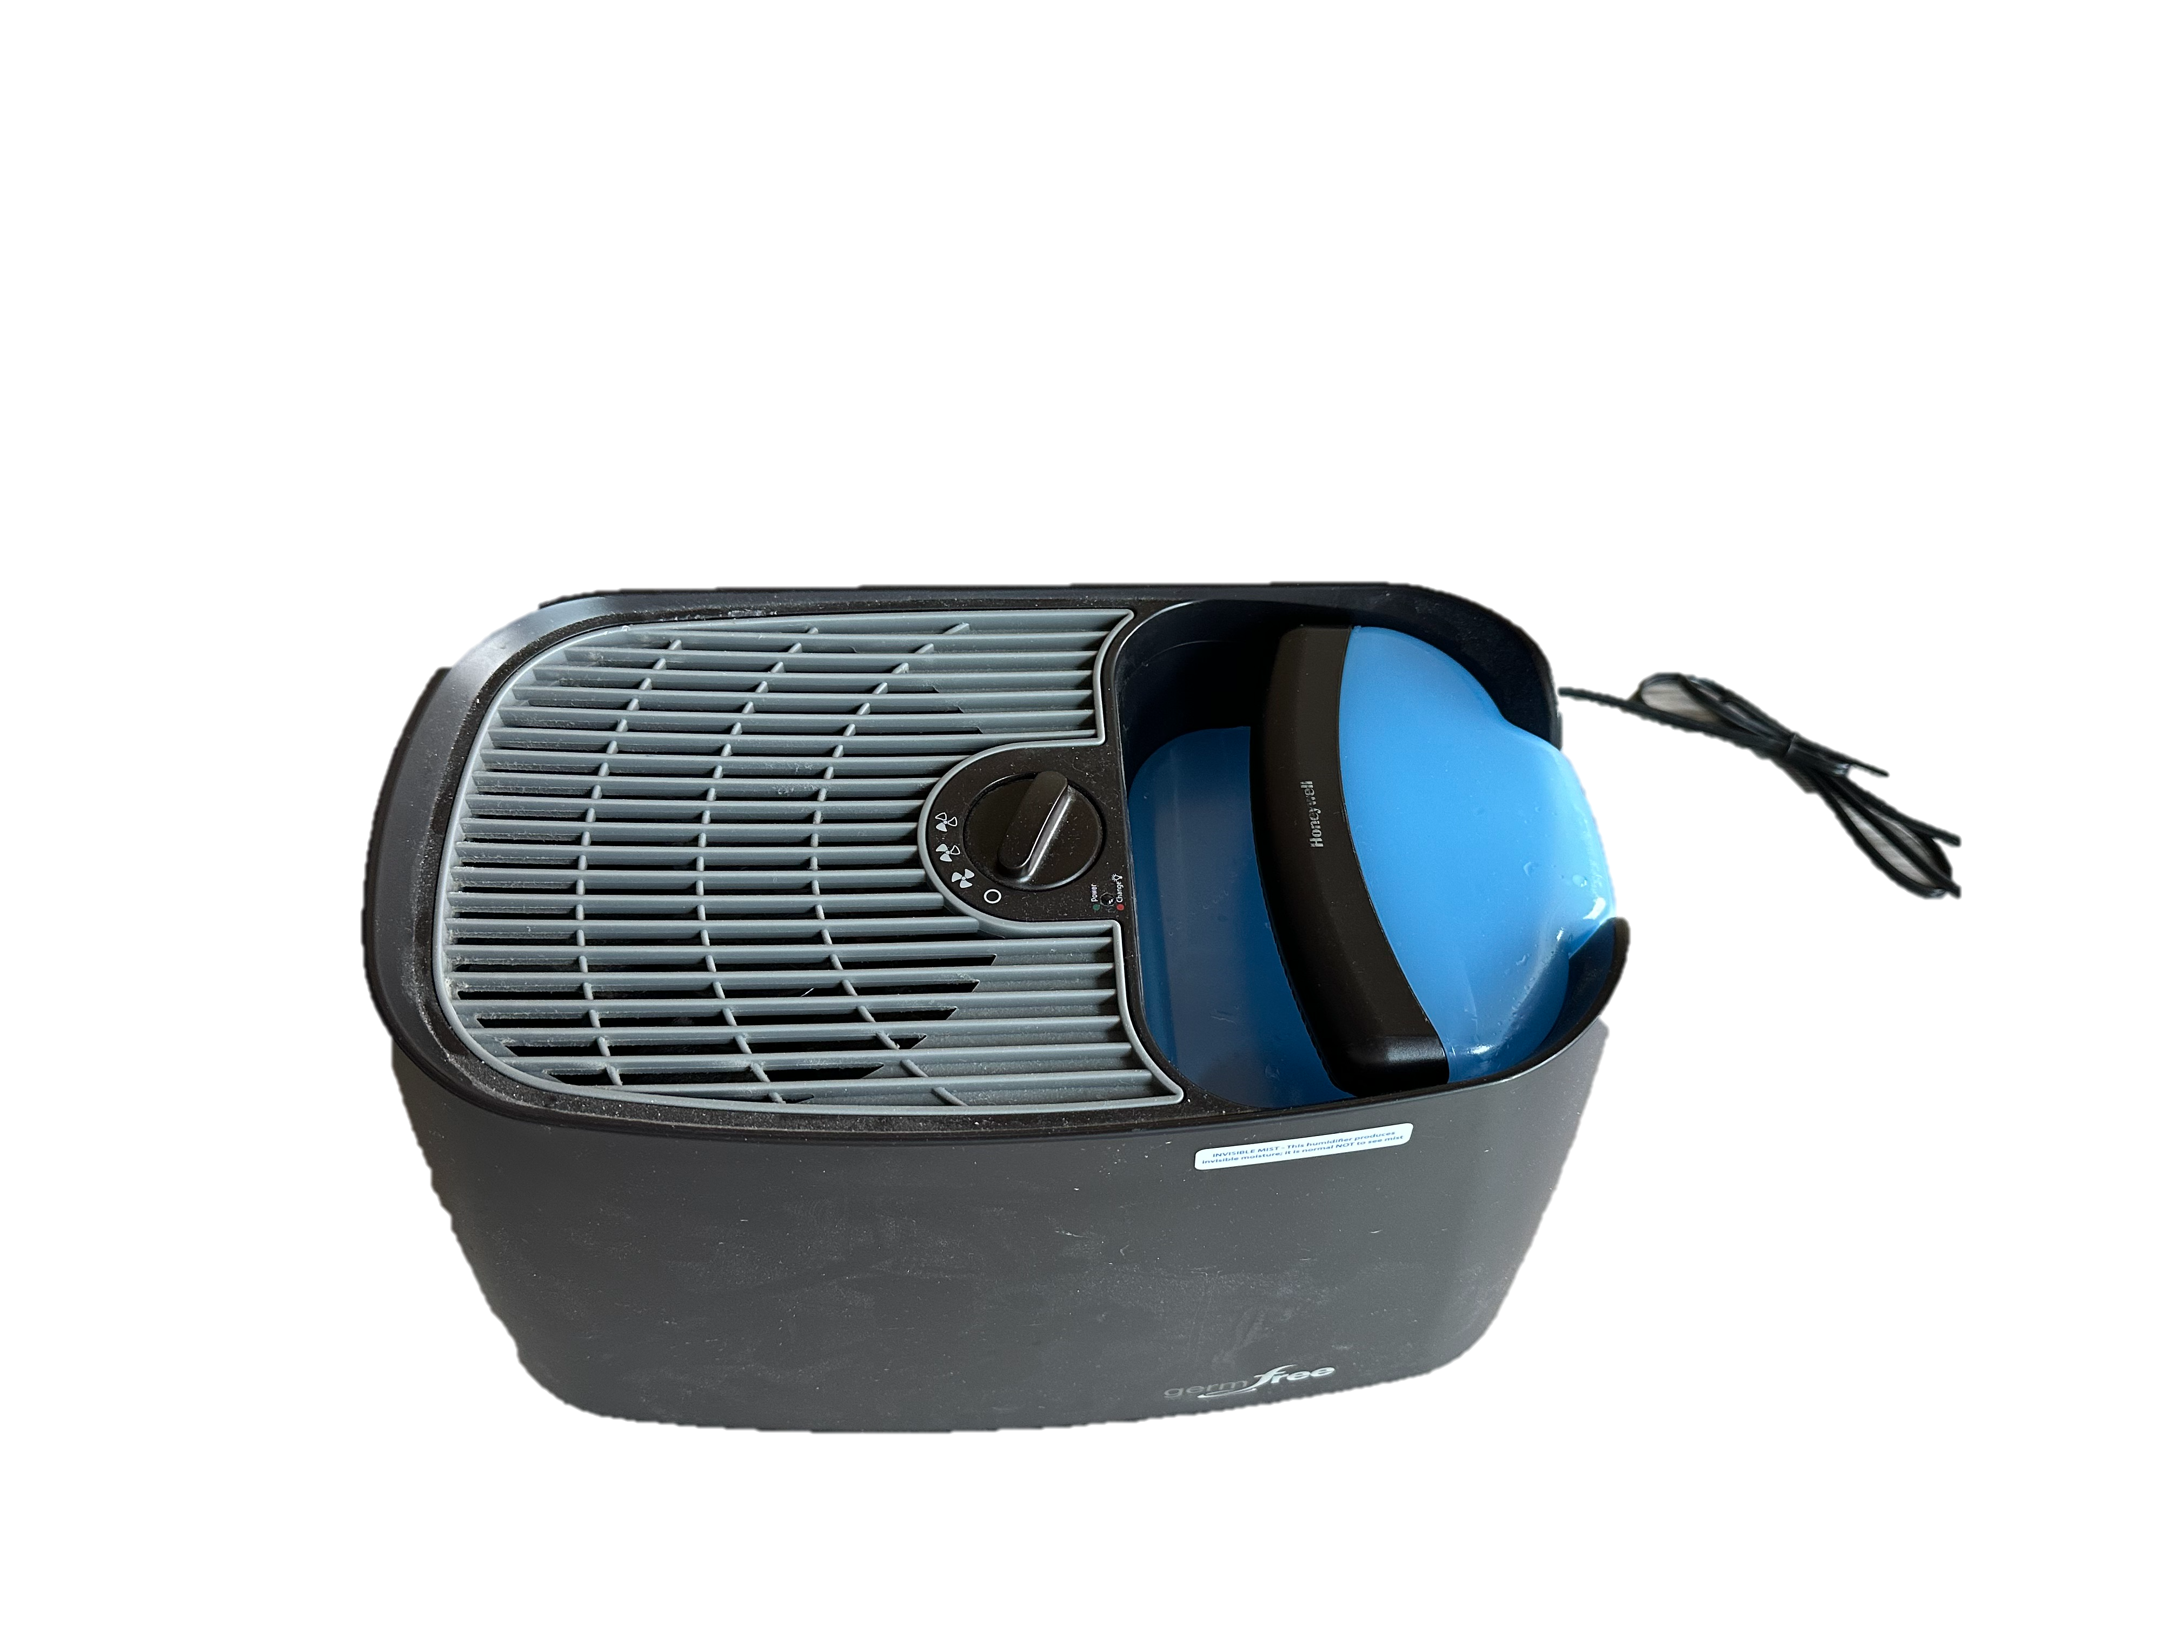

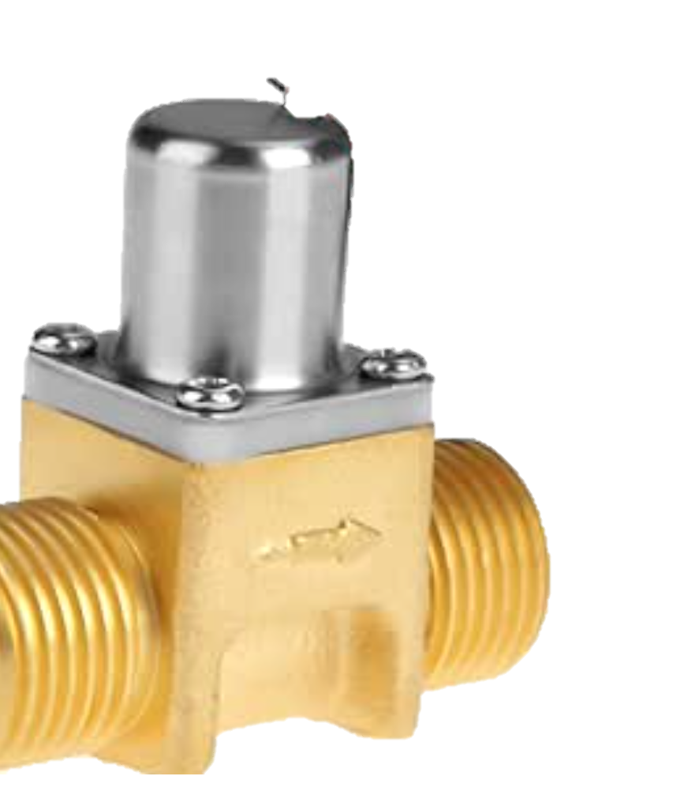
Sensor Subsystem
Humidifier Subsystem
Humidifier Fan
ON/OFF
Water Tank
Humidity Sensor
Water Input
Power Supply

Slide 17
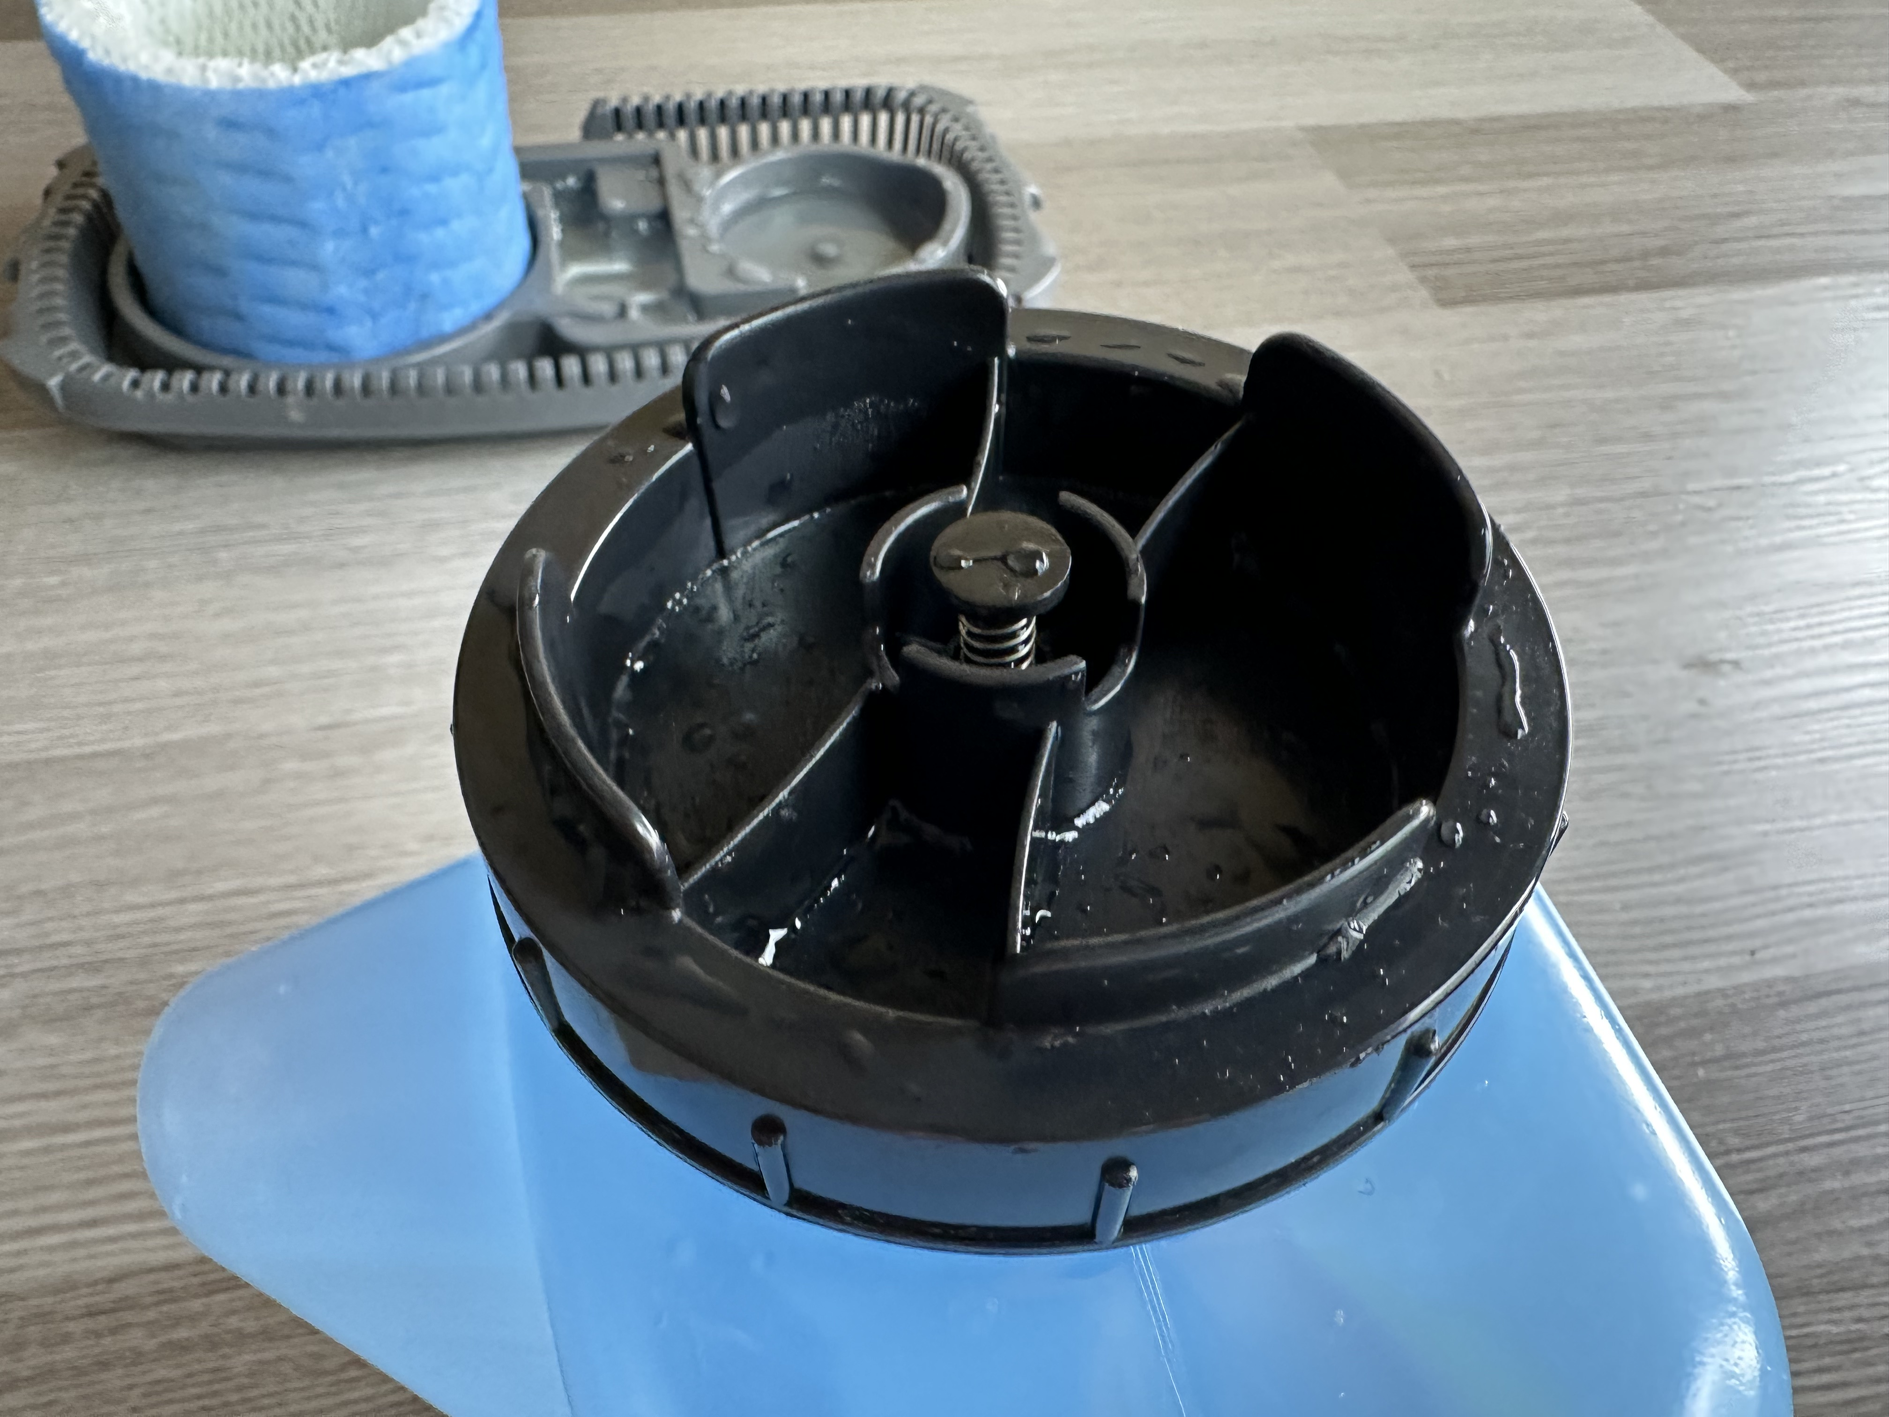

Slide 18
ESP32 Microcontroller
Humidity Sensor

Slide 19
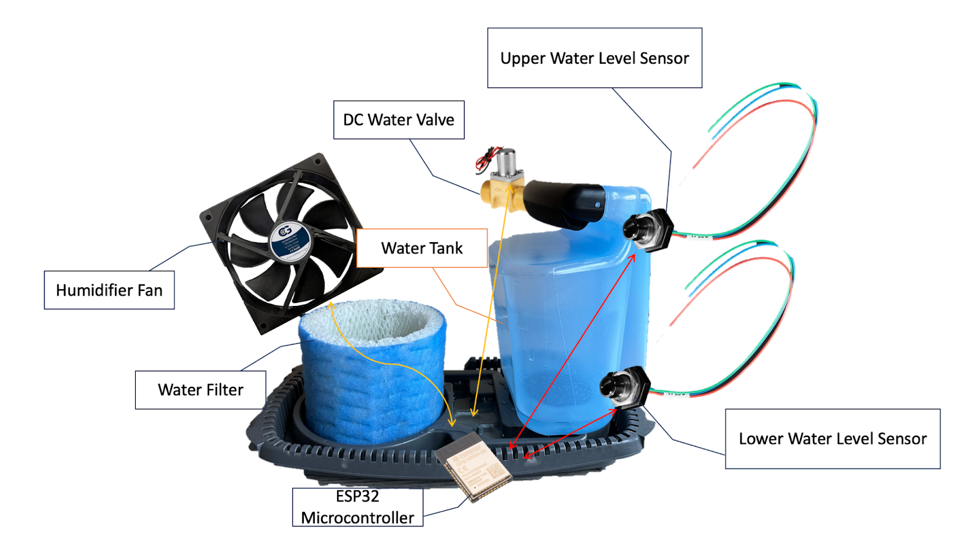
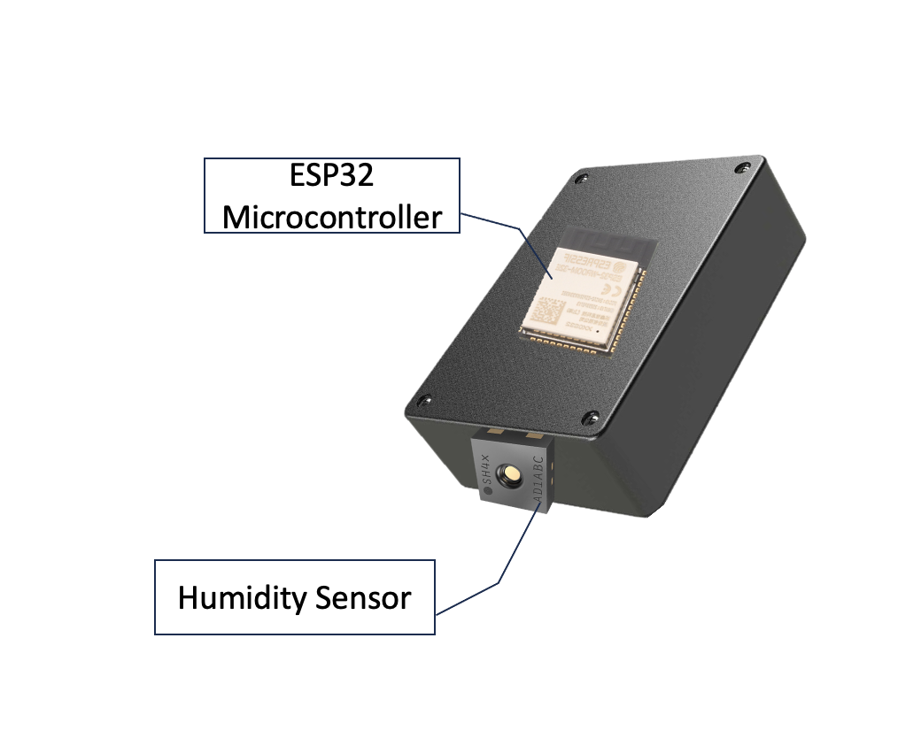
Humidifier Subsystem
Sensor Subsystem

Slide 20
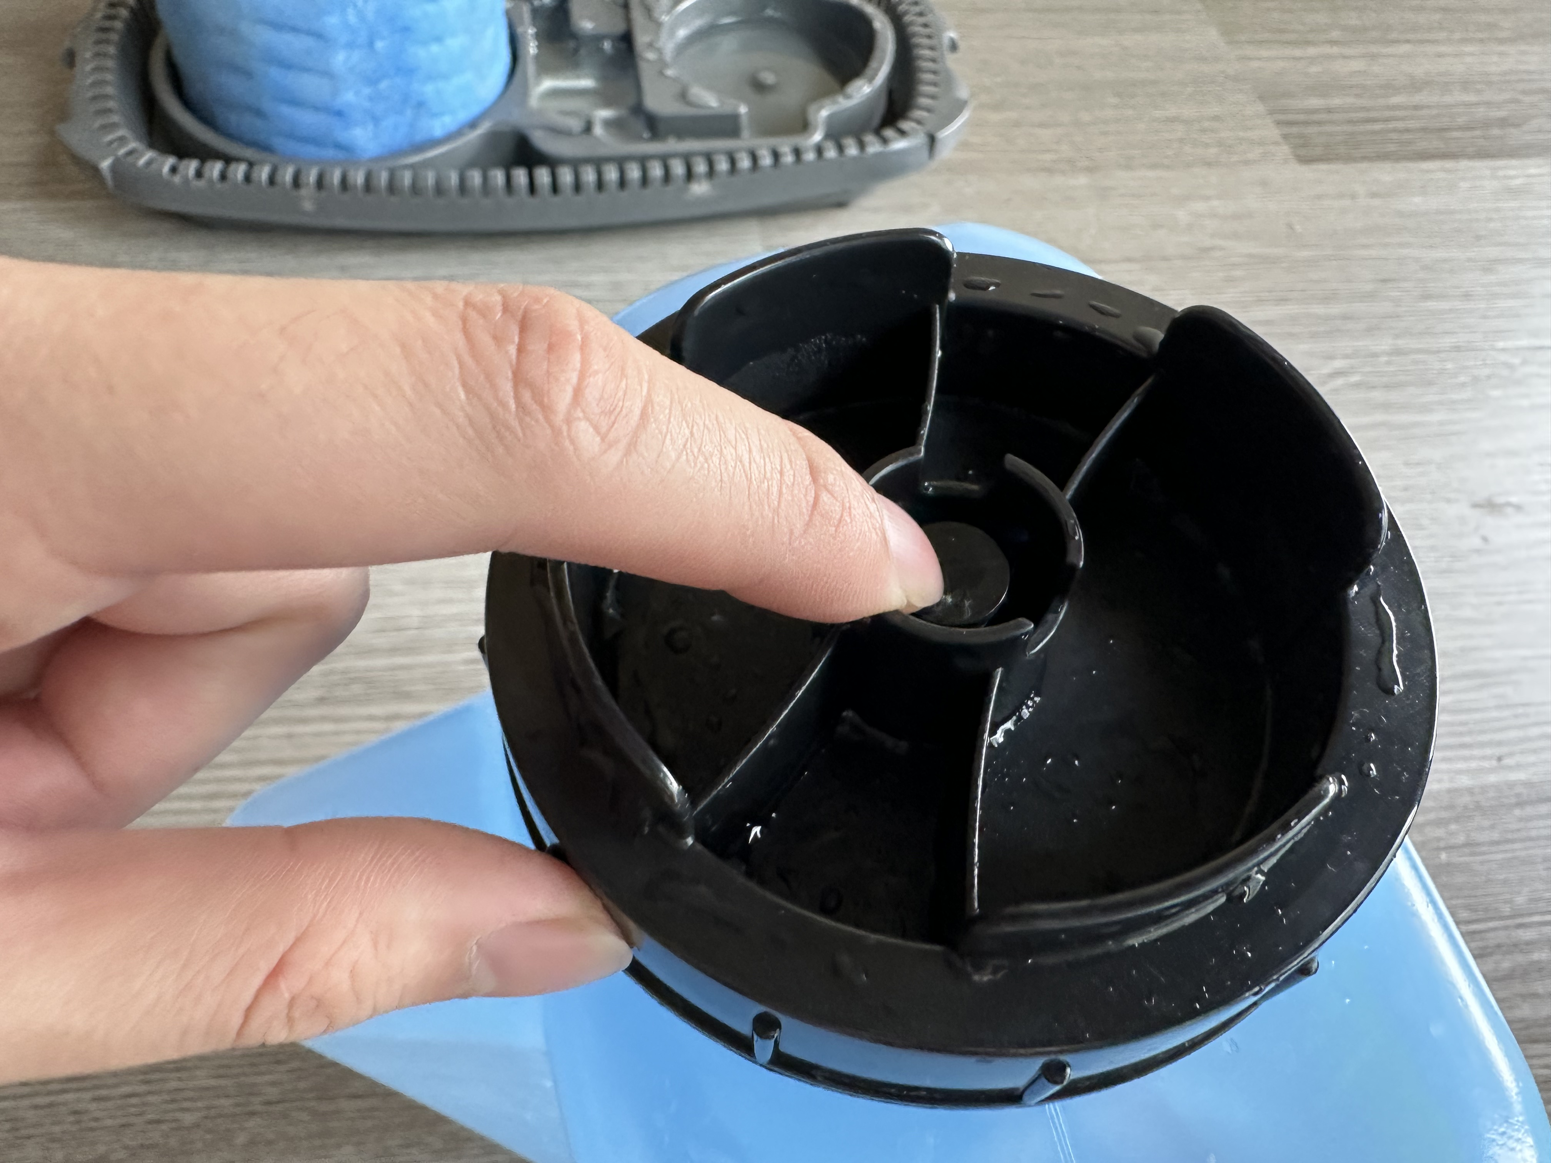

Slide 21
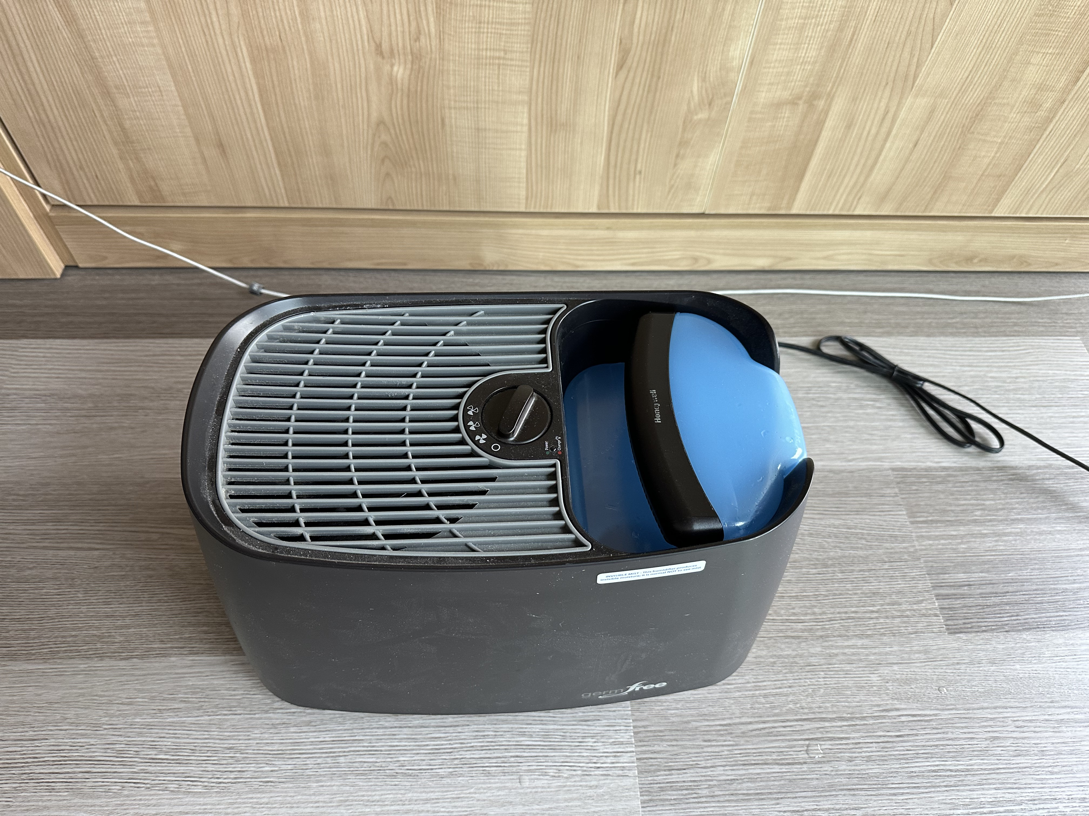

Slide 22
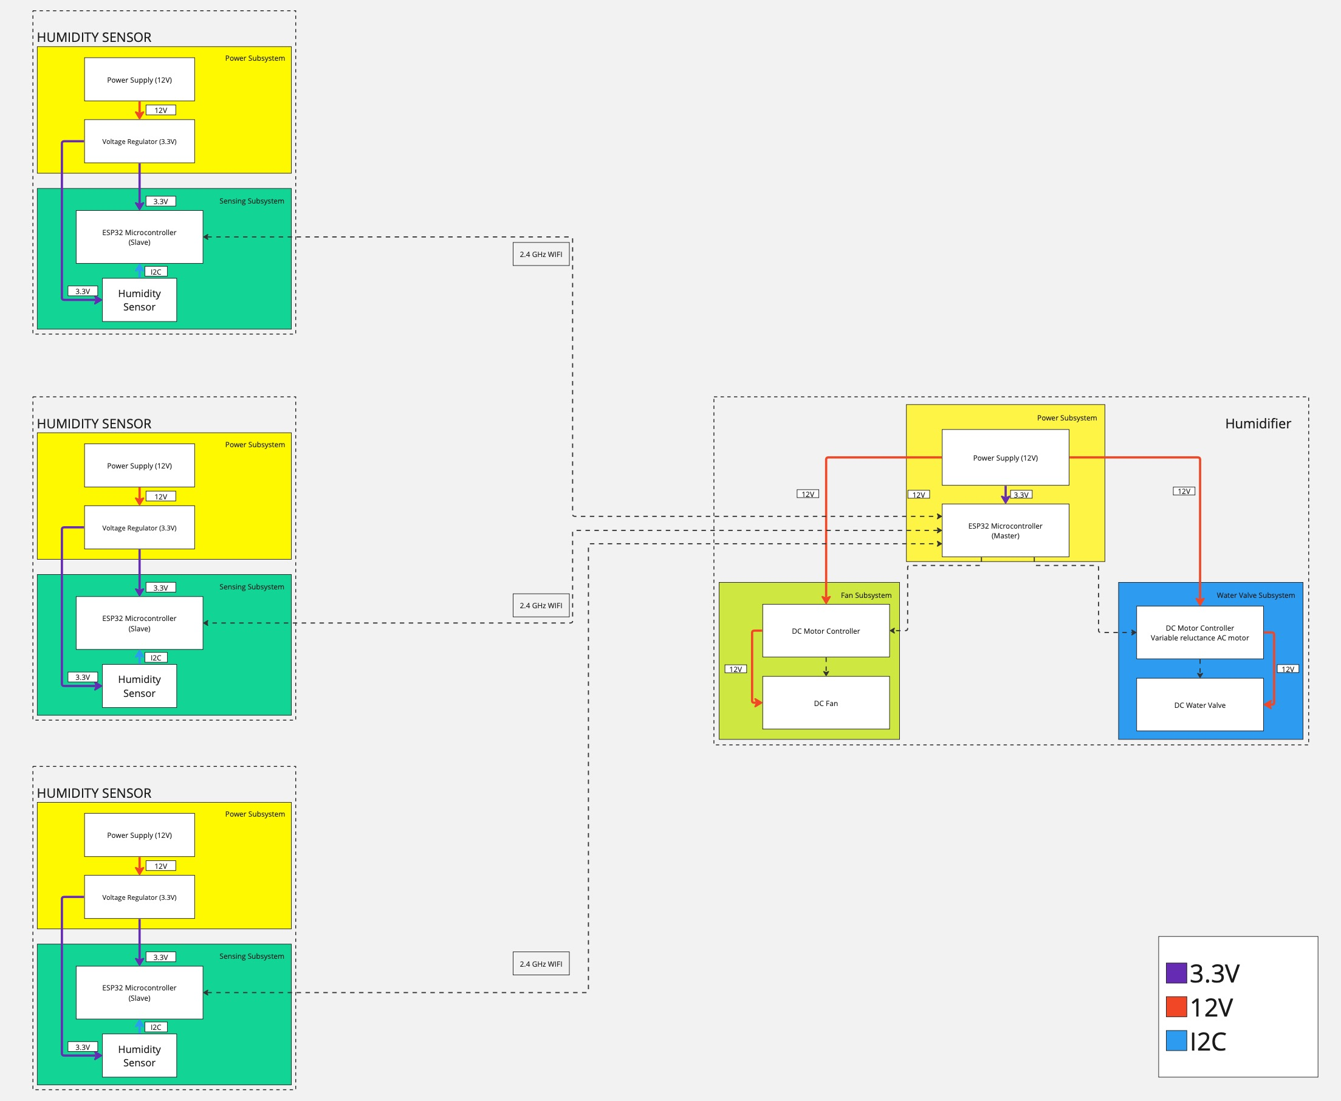

Slide 23
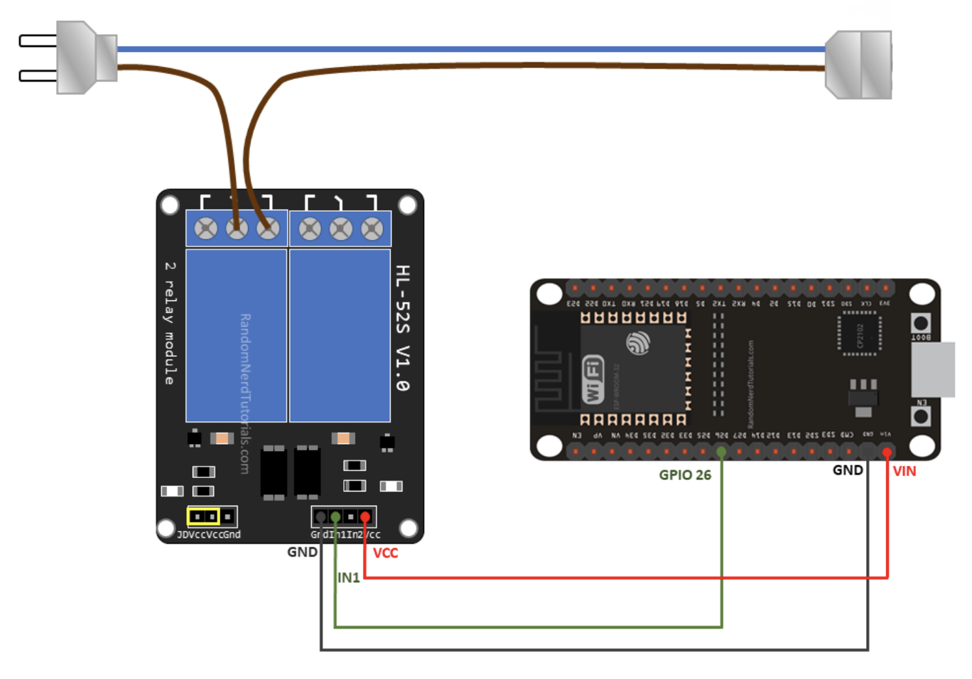
Humidifier
Relay
ESP32 Microcontroller

